Slide 1
APRN Faculty Tool Kit ANCC Certification Overview

Slide 2
APRN Faculty Toolkit
The mission of the American Nurses Credentialing Center (ANCC), a subsidiary of the American Nurses Association (ANA), is to promote excellence in nursing and health care globally through credentialing programs. Learn about:
ANCC Programs
International Organization for Standardization (ISO)
All Certification Programs
Certification Programs for Advanced Practice
Credentialing Research
Consensus Model for APRN Regulations
Accreditation
Overview
Also learn about:
Certifying through ANCC
Information for Faculty

Slide 3
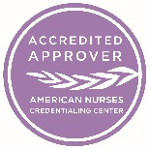
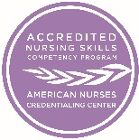
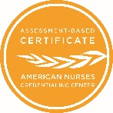
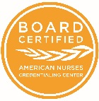
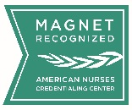
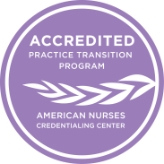
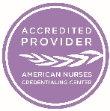
APRN Faculty Toolkit
ANCC Programs
Back to Overview Page

Slide 4
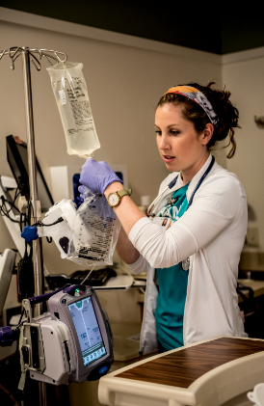
APRN Faculty Toolkit
Credentialing Research
The ANCC Institute for Credentialing Research supports research-related processes and activities for ANCC organizational and individual credentialing programs:
- Accreditation - Certification - Pathway to Excellence® - Magnet Recognition Program®
Externally, the Institute works to promote the growth of credentialing research. Credentialing is:
An umbrella term that includes accreditation, licensure, professional certification, and education.
The process by which an authorized and qualified entity grants formal recognition, or records the recognition status of individuals, organizations, institutions’ programs, processes services or products that have met predetermine standards.
The process used by hospitals and facilities to validate and recognize healthcare providers.
Back to Overview Page

Slide 5
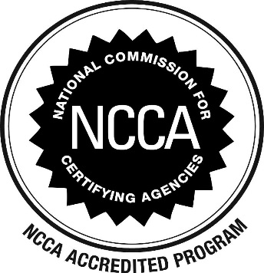
APRN Faculty Toolkit
Accreditation
ANCC certifications are accredited by:
Back to Overview Page

Slide 6
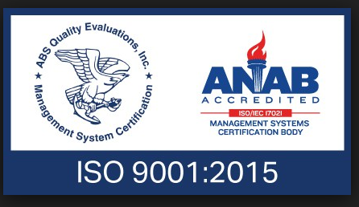
APRN Faculty Toolkit
International Standards Organization (ISO)
ANCC is the only nurse credentialing organization to successfully achieve ISO 9001:2015
Back to Overview Page

Slide 7
APRN Faculty Toolkit
All Certification Programs
Interprofessional
Nurse Practitioner
Clinical Nurse Specialist
Specialty
Types of Certifications
Back to Overview Page

Slide 8
APRN Faculty Toolkit
Certification Programs for Advanced Practice
Nurse Practitioner (NP)
Adult-Gerontology Acute Care NP AGACNP-BC
Clinical Nurse Specialist (CNS)
Adult-Gerontology CNS AGCNS-BC
Adult-Gerontology Primary Care NP AGPCNP-BC
Psychiatric-Mental Health NP PMHNP-BC (Across the Lifespan)
Family NP FNP-BC
Pediatric Primary Care NP PPCNP-BC (Retires December 31, 2018)
Specialty
Nurse Executive, Advanced NEA-BC
Back to Overview Page

Slide 9
APRN Faculty Toolkit
Consensus Model for APRN Regulations
Goals
The Consensus Model supports the goals of the ANCC APRN certification process and will align the inter-relationships among licensure, accreditation, certification, and education to create a more uniform practice across the country.
Taking Charge
ANCC is leading the way to ensure that certification bodies are involved in shaping this transformative model and guiding the implementation process.
FAQs
ANCC looks forward to the progress and opportunities the consensus model will provide for the profession, APRNs, and patients. For additional information, please visit the FAQs page.
Back to Overview Page

Slide 10
APRN Faculty Toolkit
Certifying through ANCC
ANCC's internationally renowned credentialing programs certify and recognize individual nurses in specialty practice areas. The program recognizes healthcare organizations that promote nursing excellence and quality patient outcomes, while providing safe, positive work environments. Take advantage of becoming ANCC Certified. Learn about the application process and the benefits:
Licensure
About Certification Renewal
Benefits of Becoming ANCC Certified
Why Become ANCC Certified?
Steps for Students to Renew
Steps for Students to Apply
Back to Overview Page

Slide 11
APRN Faculty Toolkit
Licensure
When applying to test for an ANCC Certification, be sure to review eligibility criteria for each application, including the required licensure. Learn what a licensure is:
Processes by which an agency of a state government grants permission to an individual to engage in the practice of a profession e.g. nursing and prohibits all others from legally practicing in that profession.
Authorizes the use of a particular title, such as Registered Nurse (RN), Nurse Practitioner (NP), Clinical Nurse Specialist (CNS), etc. For purpose of ANCC exams we typically require a RN license.
Licensure protects the public by ensuring an entry level of professional competence.
Back to Certifying through ANCC Page
Back to Overview Page

Slide 12
Create an ANCC account.
Submit official transcripts and Validation of Advanced Practice Nursing Education Form.
When ready to test, complete and submit your application through Our Certifications page.
Apply for your verification so that it will be generated as soon as you become certified. The first verification is free.
View the study aids that are available for each certification by visiting the main Our Certifications page, click on your certification specialty, and scroll to the bottom.
Once you receive your Authorization to Test letter, schedule your exam through Prometric.
Take your exam. The results are available to you immediately after testing.
Become certified once you pass the test or degree is conferred )if you test prior to degree conferral date).
Renew your ANCC certification every five years.
APRN Faculty Toolkit
Steps for Students to Apply
Back to Certifying through ANCC Page
Back to Overview Page

Slide 13
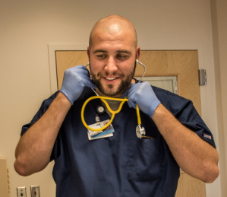
Renewal is due every 5 years.
Certification can be renewed through various professional development and practice activities.
View the certification renewal requirements.
APRN Faculty Toolkit
Steps for Students to Renew
Back to Certifying through ANCC Page
Back to Overview Page

Slide 14
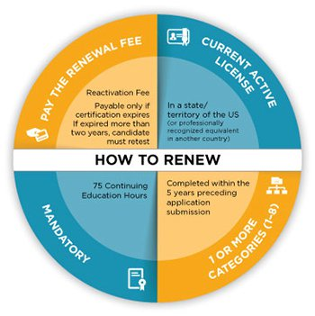
APRN Faculty Toolkit
About Certification Renewal
Apply online and record your achievements throughout your renewal cycle. You must renew your certification at the designated periods.
When renewal is due, your professional milestones are available in your account for your convenience.
For more information, check out the Certification Renewal Forms.
Back to Certifying through ANCC Page
Back to Overview Page

Slide 15
APRN Faculty Toolkit
Certified nurses are increasingly in demand. Through ANCC certification programs, a nurse can validate their contributions to efficient patient care and become recognized as experts in their field. Our certifications:
Incorporate the latest evidence-based practice criteria to ensure that nurses have demonstrated knowledge and documented experience in their specialties.
Bring professional and personal satisfaction.
Inspire confidence while giving the first impression employers seek.
Are an indicator of life-long learning and maintenance of competence.
Why Become ANCC Certified?
Back to Certifying through ANCC Page
Back to Overview Page

Slide 16
APRN Faculty Toolkit
Benefits of Becoming ANCC Certified
ANCC is the world’s largest and most prestigious nurse credentialing organization.
ANCC has certified more than 233,000 nurses.
ANCC offers an Expedite Review Procedure.
Applicants are able to test before graduating.
ANCC exams are developed by volunteer subject matter experts and maintained at ANCC headquarters.
Back to Certifying through ANCC Page
Back to Overview Page

Slide 17
APRN Faculty Toolkit
Follow Us on Social Media.
Faculty complete the Validation Education (VOE) Form.
Verify Student Certifications.
Information for
Faculty
Perform GAP analysis, if needed
All courses listed on the form must appear on a transcript with a grade.
Send the form electronically to aprnvalidation@ana.org.
How to help your APRN graduate students:
Learn About the Promotions Via Social Media.
Back to Overview Page

Slide 18
APRN Faculty Toolkit
Verify Student Certifications
Request to set up an account by contacting us at certificationoutreach@ana.org
Log into the free verification portal
Enter “username” and “password” provided by ANCC representative.
Enter demographic information indicated.
Last name is required
Be sure to only enter state abbreviations.
Back to Information for Faculty Page
Back to Overview Page

Slide 19
APRN Faculty Toolkit
Follow Us on Social Media
Visit our main Facebook page, ANCC Certification and learn about the benefits of becoming ANCC certified.
Join our Facebook Groups:
ANCC Twitter Page
ANCC: PreceptorMatch.com Facebook Group
ANCC LinkedIn Page
ANCC: Graduate Student Facebook Group
Back to Information for Faculty Page
Back to Overview Page

Slide 20
APRN Faculty Toolkit
Learn about Promotions via Social Media
Follow us on all social media platforms:
Take advantage of new grad promo codes.
Get an even higher discount through ANA membership.
Learn about upcoming free webinars.
Facebook
Twitter
LinkedIn
Back to Information for Faculty Page
Back to Overview Page

Slide 21
APRN Faculty Toolkit
Have Additional Questions?
Contact our Customer Service Center at 1.800.248.2378 or Via email at certificationoutreach@ana.org

